Slide 1
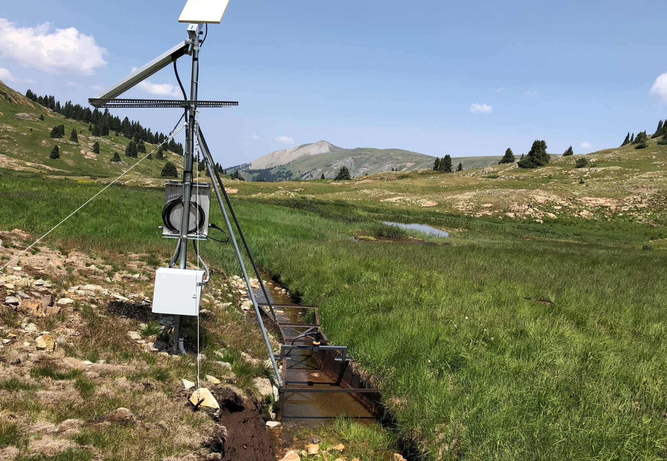

BLM Acquisition Project
Mineral Point Ditch

Slide 2
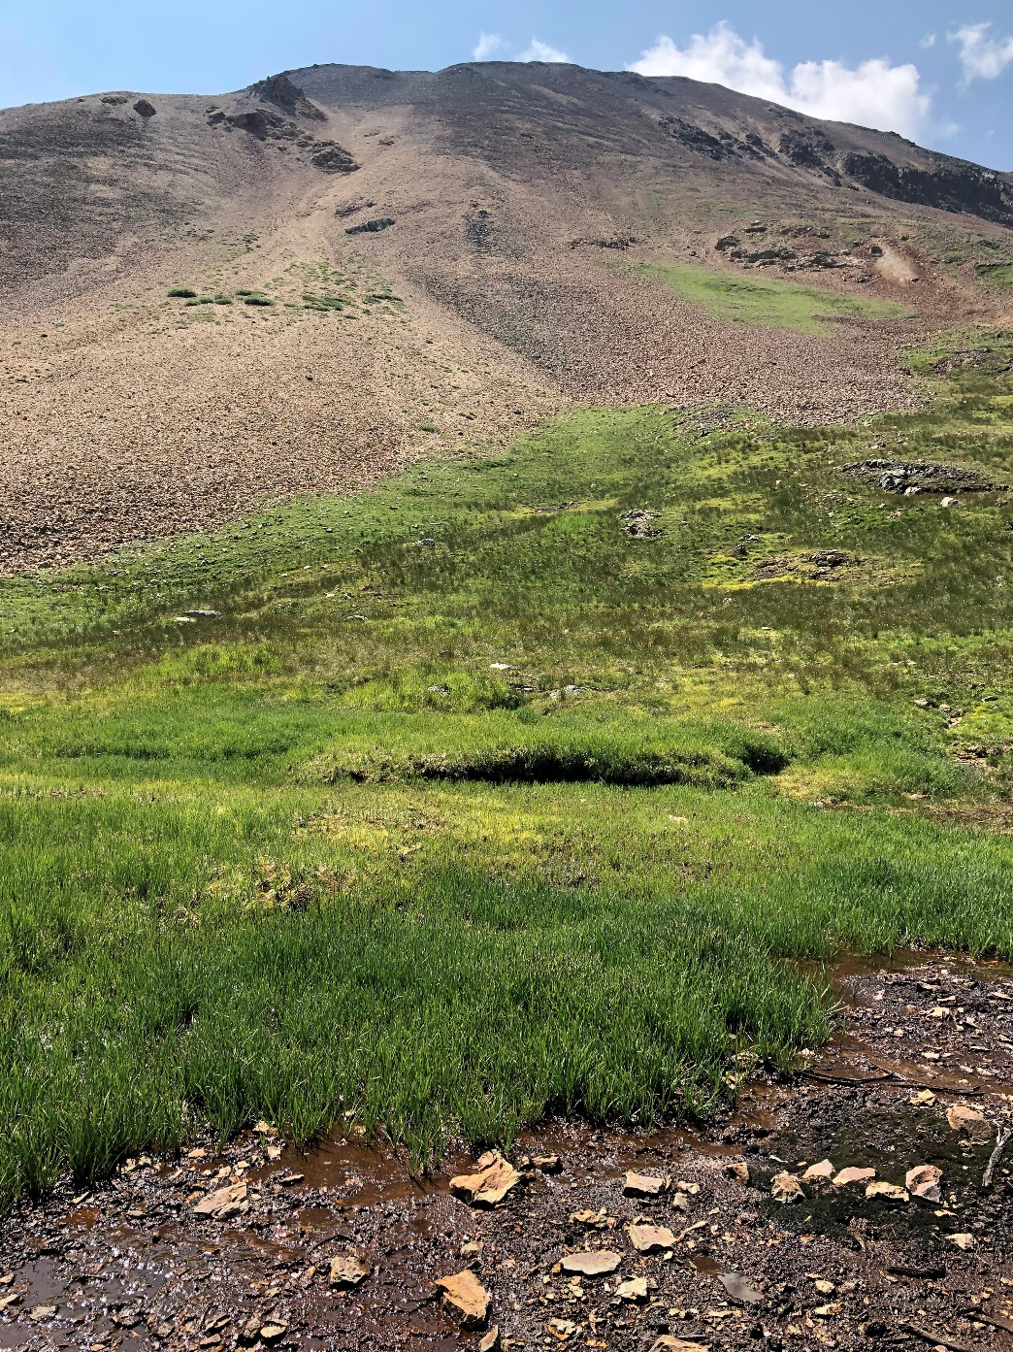
Why did BLM pursue this project?
Expected Benefits:
Restore flows to Burrows Creek and Animas River.
Dilute and flush out heavy metals in Burrows Creek.
Restore hydrology of fens and wetlands adjacent to Burrows Creek, which filter out heavy metals.
Facilitate remediations of AML sites adjacent to ditch.
Wetland complex at base of Houghton Mtn.

Slide 3
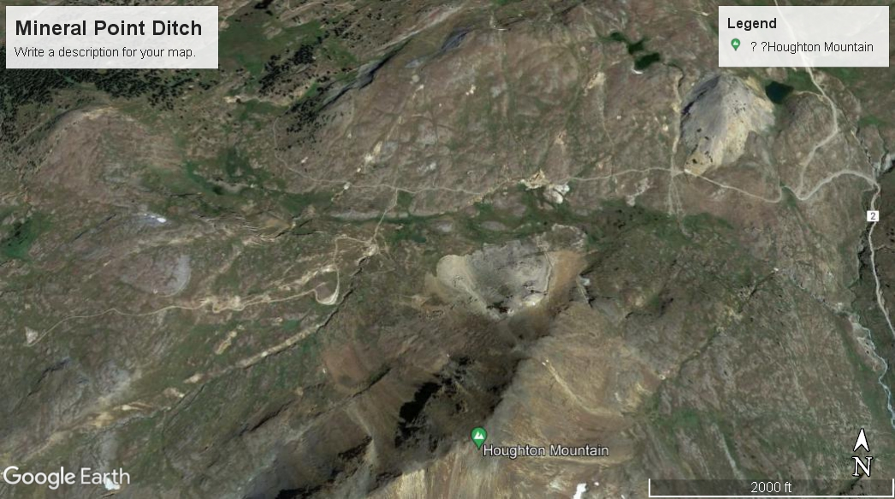
Mineral Point Ditch - Location
Miramonte
Reservoir
Lower Terminus:
Confluence With
Little Cimarron River
Lower Terminus:
Confluence with Beaver Creek
< Little Cimarron River
Lone Cone
Burrows Creek
Upper Terminus:
Headwaters
Upper Terminus:
Headwaters
Animas River

Slide 4
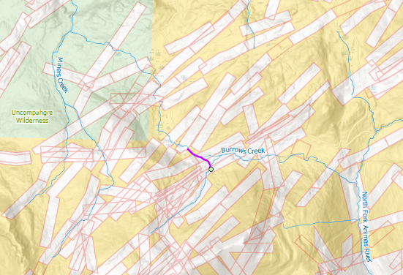
Mineral Point Ditch - Location
Ditch Route

Slide 5
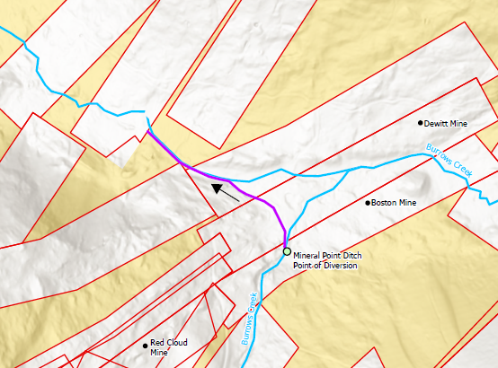
Mineral Point Ditch - Location
Ditch Route

Slide 6
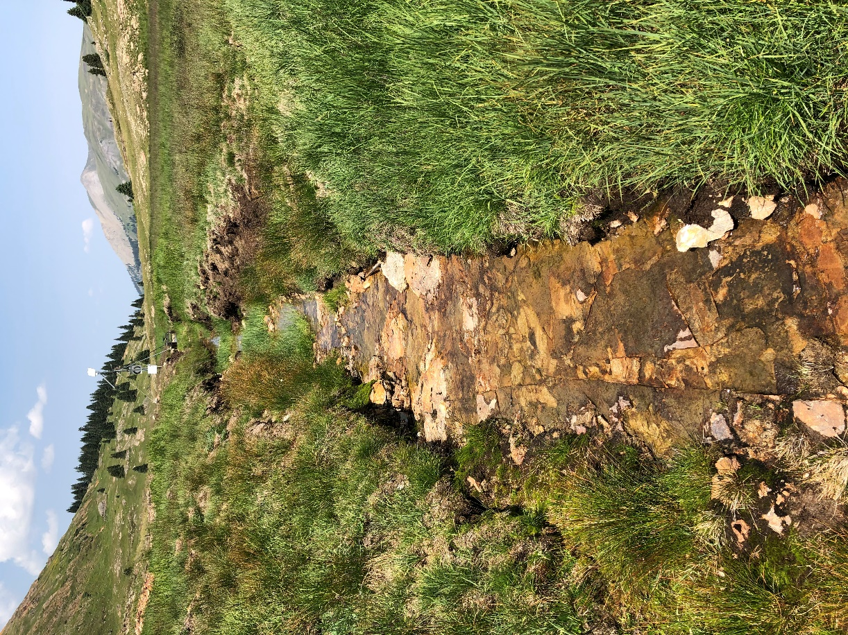
Water Right Characteristics
Decreed for 11.0 cfs, 1956 priority.
Transbasin diversion from Animas River watershed (Burrows Creek) to Uncompahgre River watershed (Miners Creek).
Uses: irrigation of 140 acres, stock watering, domestic, fish culture.
Historically used on a variety of lands near Ouray.
Extremely variable diversion history.
Typical ditch construction.

Slide 7
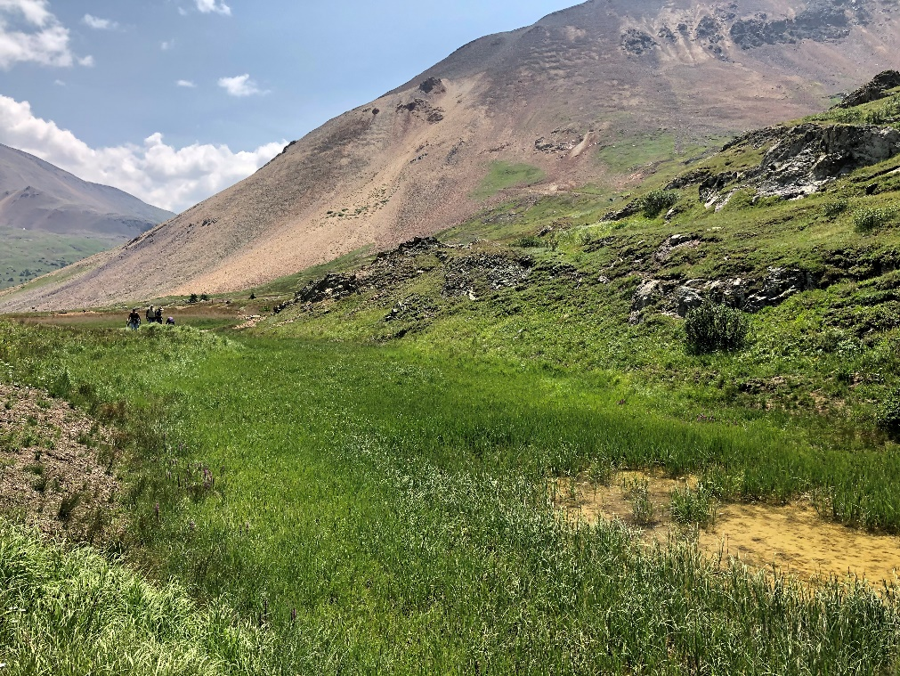
Ditch Characteristics
Ditch is fully operational and includes a measuring device with satellite telemetry.
Constructed ditch length is approximately 1,000 feet.
Embankments constructed with mine tailings.
Ditch delivers water to a large wetlands complex at headwaters of Miners Creek right after water passes the measurement device.
Significant lag time before ditch flows reach the Ouray area.
Wetlands receiving water from Mineral Point Ditch.

Slide 8
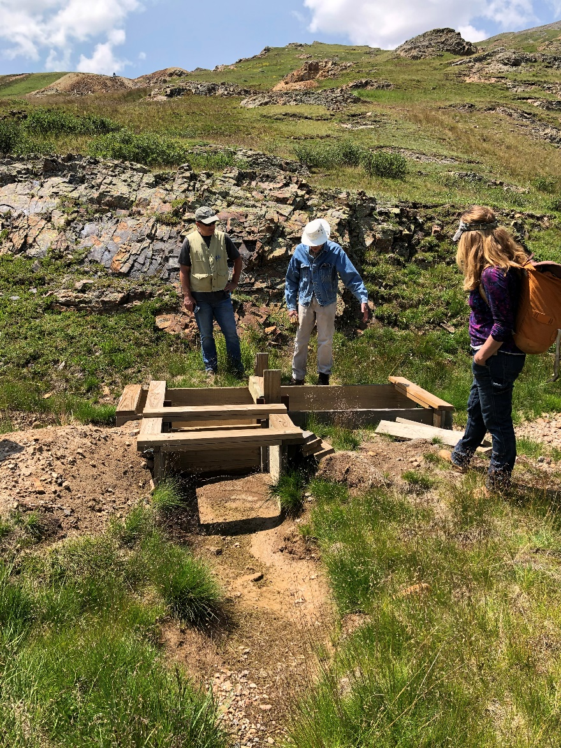
Transaction Characteristics
BLM acquired 10.75 cfs in October 2023 and 0.25 cfs in February 2025.
BLM closed ditch after October 2023 transaction.
Funding obtained from BLM’s Abandoned Mine Land Program and Land and Water Conservation Fund.
TU provided funding for a Quiet Title Action on the 0.25 cfs interest.
Ditch turnback structure.

Slide 9
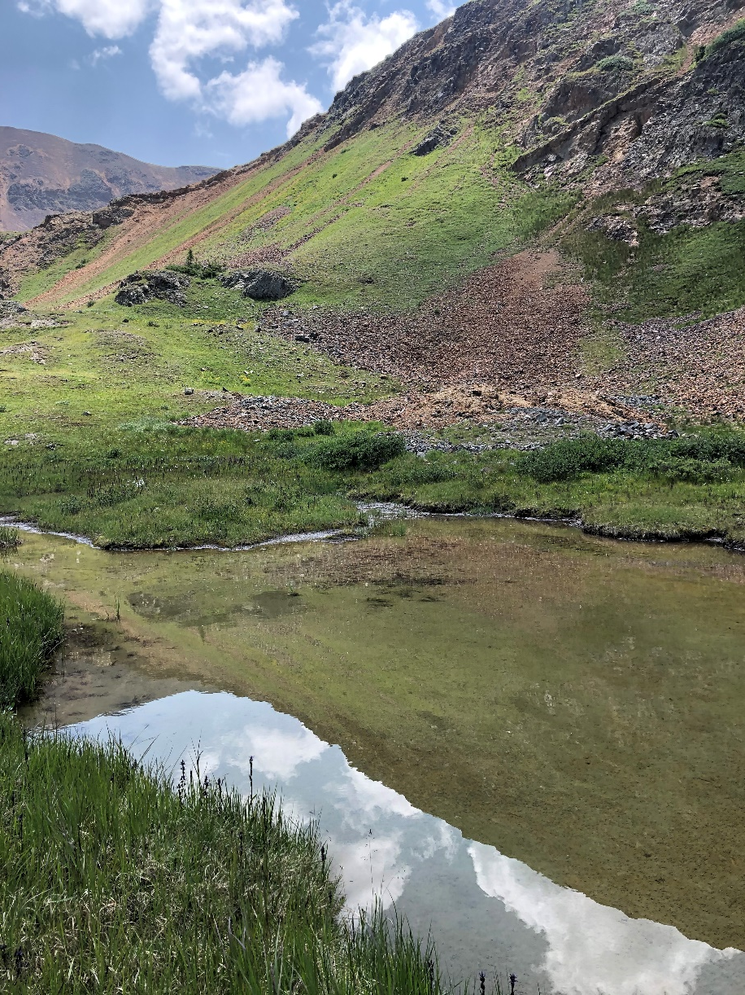
Junior Instream Flow Water Right
CWCB has appropriated:
  3.75 cfs May 1 to June 15
  1.6 cfs June16 to July 15
  0.58 cfs July 16 to Oct 31
  0.19 cfs Nov 1 to Mar 31
Flow rates designed to support macroinvertebrate community.
Macro studies provided by Mountain Studies Institute.
Interested parties have until June 2 to file protests.
Wetlands at base of Houghton Mountain.

Slide 10
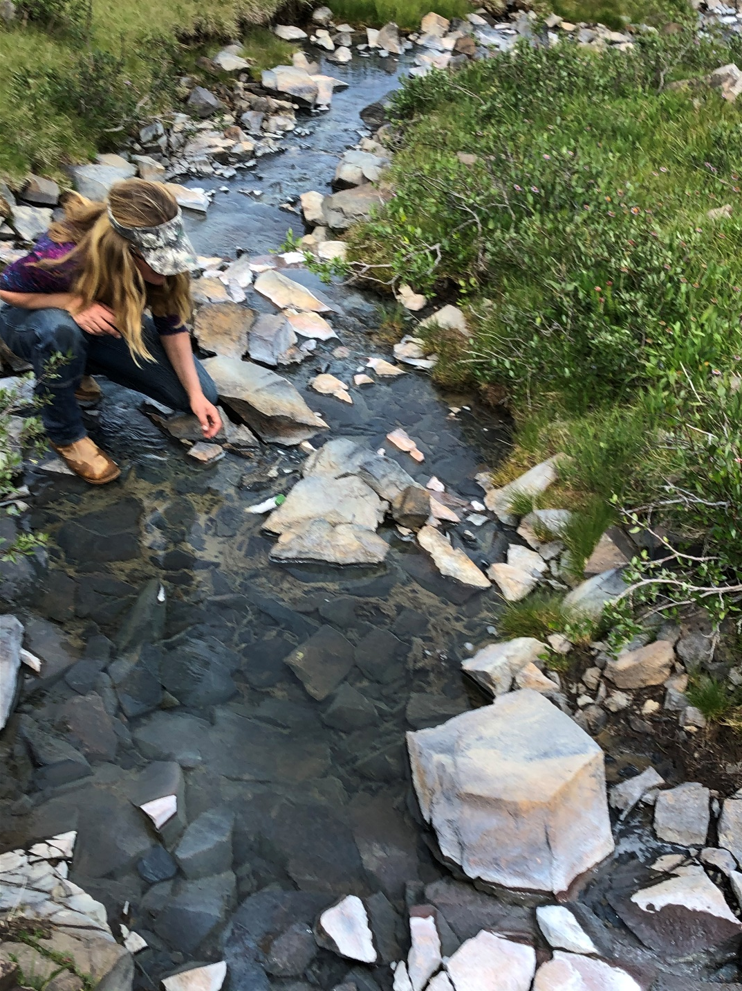
BLM Water Right Lease To CWCB
CWCB has preliminarily accepted BLM’s offer.
Change of water right to be based on 1986-2002 diversion records.
Changed water right will be protected throughout Burrows Creek.
The changed water right will be used to obtain a more senior priority for portions of the instream flow water right.
CWCB will vote on the lease at its July boarding meeting.
Burrows Creek downstream from ditch.

Slide 11
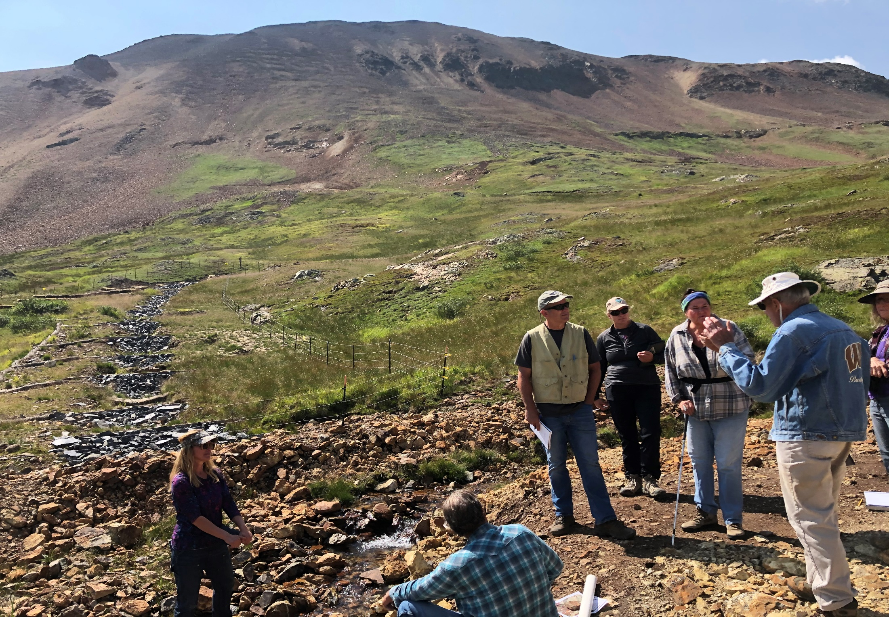


Project Partners

Slide 12
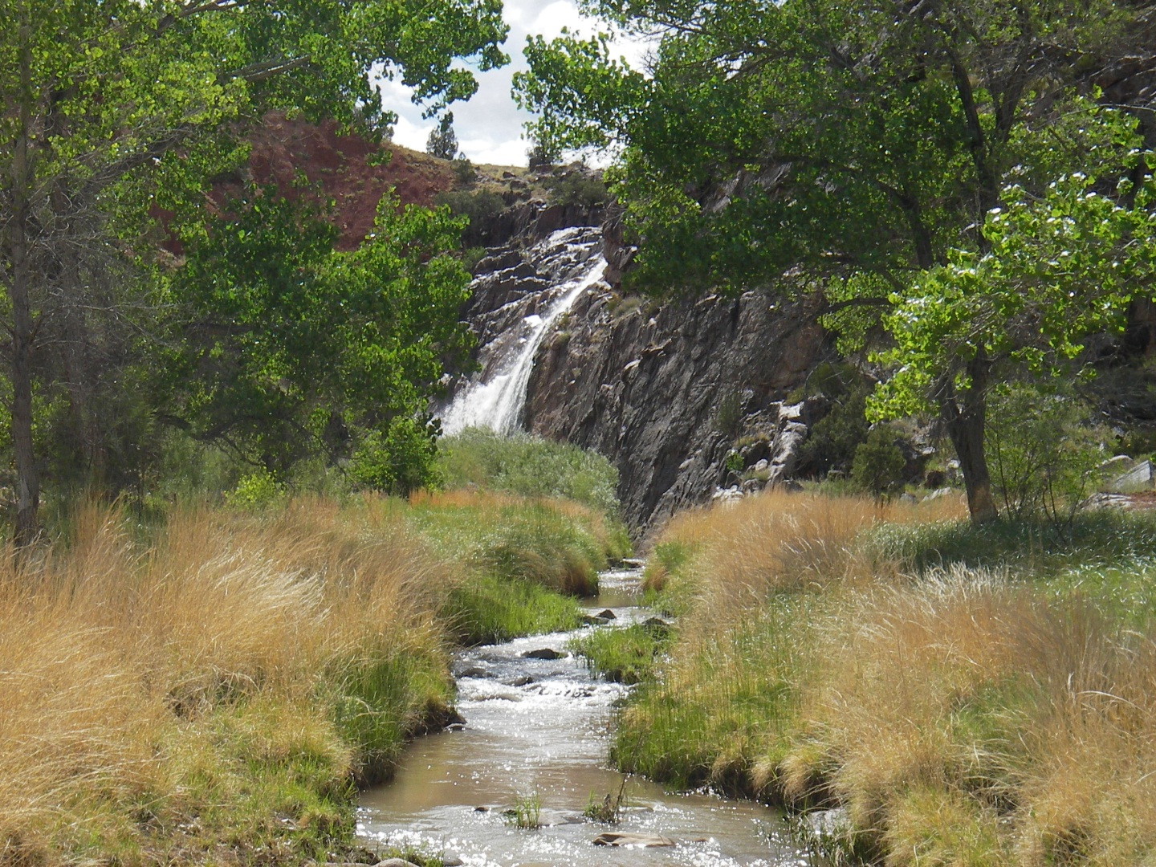

Questions for BLM?
Contact Roy Smith at r20smith@blm.gov or 303-239-3940
Big Dominguez Creek
near Grand Junction
Granite Creek at Colorado-Utah border

